Slide 1
Boundary Elements for Engineering
BEE v1.0
Coupled Elasticity Flow Module
Elasticity Module
Flow Module
BEE Main
Coupled
Elasticity
Laplace Module
Coupled Flow Laplace Module
Laplace Module

Slide 2
BEE 1.0
Coupled Elasticity Flow Module
Boundary Element Method (BEM) based
is capable of 2D & 3D analysis
has CPU/GPU parallel computing capability
has a modular structure
Elasticity Module
Flow Module
BEE Main
Coupled
Elasticity
Laplace Module
Coupled Flow Laplace Module
Laplace Module
BEE v1.0
Boundary Elements for Engineering

Slide 3
BEE 1.0
Coupled Elasticity Flow Module
Ease of modeling directly from solid data
Meshing with constant triangular elements
Elasticity Module
Flow Module
BEE Main
Coupled
Elasticity
Laplace Module
Coupled Flow Laplace Module
Laplace Module
BEE v1.0
Boundary Elements for Engineering

Slide 4
BEE 1.0
1. Laplace Module
Coupled Elasticity Flow Module
Analysis of Laplace operator
based problems
Acoustic
Electric field
Magnetic field
Heat transfer
Elasticity Module
Flow Module
BEE Main
Coupled
Elasticity
Laplace Module
Coupled Flow Laplace Module
Laplace Module
BEE v1.0
Boundary Elements for Engineering

Slide 5
BEE 1.0
2. Stoke’s Flow Module
Coupled Elasticity Flow Module
Analysis of Stoke’s flow
based problems
Microfluidics problems
Low speed flows
High viscosity flows
Particle tracking in micro channels
Elasticity Module
Flow Module
BEE Main
Coupled
Elasticity
Laplace Module
Coupled Flow Laplace Module
Laplace Module
BEE v1.0
Boundary Elements for Engineering

Slide 6
BEE 1.0
3. Elastic Module
Coupled Elasticity Flow Module
Analysis of elastic and elastodynamic problems
Elastic deformation problems
Elastic wave problems
Elastic vibrations and modal analysis
Elasticity Module
Flow Module
BEE Main
Coupled
Elasticity
Laplace Module
Coupled Flow Laplace Module
Laplace Module
BEE v1.0
Boundary Elements for Engineering

Slide 7
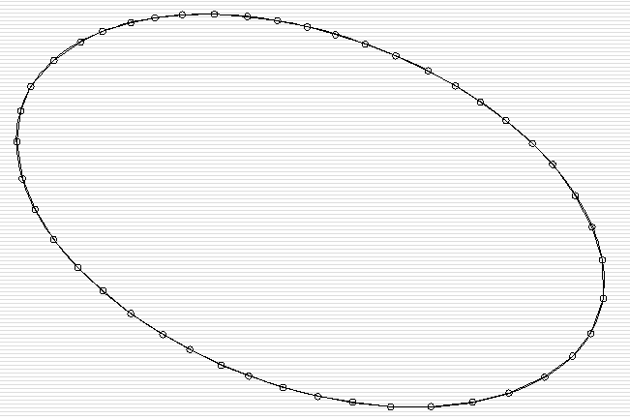
Real System
Physical Model
Mathematical Model
Governing Equations
S
Differential Equations
V
Integral equations
Governing equations are transformed into integral equations in the form of boundary integrals
To determine the unknown field variables:
Aforementioned boundary integral equations are solved numerically
BEE v1.0
Boundary Elements for Engineering

Slide 8
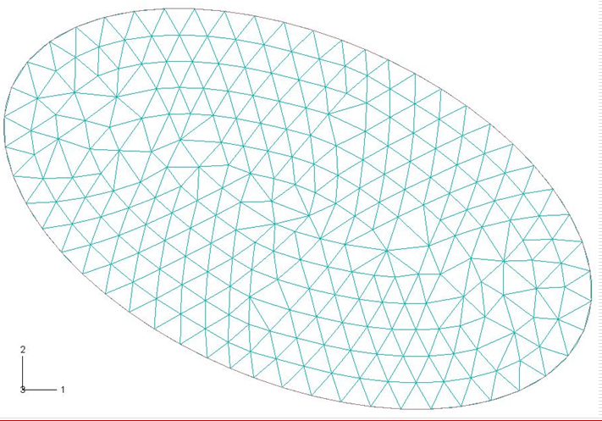
Boundary Element Method: Advantage and Disadvantages
FEM or FVM:
The continuity between the elements is satisfied approximately within the solution domain
BEM:
The fundamental solutions are obtained analytically; in this respect governing eqns are integrated in exact sense.
Continuity within the solution domain is satisfied inherently.
The resultant integral equations are solved numerically.
In this respect, BEM is also called as a semi-analytic method.
In many problems BEM solutions are more accurate than FEM or FVM solutions
BEE v1.0
Boundary Elements for Engineering

Slide 9
Boundary Element Method: Advantage and Disadvantages
Meshing of the surfaces reduces both the number of unknowns and the time for modeling especially for 3D and complicated geometries.
There is no need for continuity and compatibility between the elements of the mesh. It is easy and fast to mesh the domain. Also, parallel meshing algorithms can be employed (in FEM or FVM, it is not possible to use parallel meshing algorithms)
Also, it is not necessary to bound the system at a prescribed location. Very large solution domains can be analyzed.
FEM model for extrusion problem.
İzzet Özdemir, Hakan Kalkan, Manuf. Engng. Dept., Atılım University
BEE v1.0
Boundary Elements for Engineering

Slide 10
Boundary Element Method: Advantage and Disadvantages
BC: Uniform velocity
Flow domain
BC: Zero traction
BC: Zero velocity
Particle
Problems requiring extensive remeshing, boundary element method serves unique advantages.
BEE v1.0
Boundary Elements for Engineering

Slide 11
Boundary Element Method: Advantage and Disadvantages
In FEM or FVM:
As particle moves, the mesh needs to be modified.
At some instants, remeshing is required.
BEE v1.0
Boundary Elements for Engineering

Slide 12
Boundary Element Method: Advantage and Disadvantages
In FEM or FVM:
For some instances, the time required for the remeshing can be more than the time required for the solution of the problem
BEE v1.0
Boundary Elements for Engineering

Slide 13
Boundary Element Method: Advantage and Disadvantages
In FEM or FVM:
Also, each remeshing requires interpolation, which involves errors, leading to wrong solutions or sometimes no solution.
BEE v1.0
Boundary Elements for Engineering

Slide 14
Boundary Element Method: Advantage and Disadvantages
In BEM:
Moving only the elements on the particle is enough. No need of interior mesh within the solution domain.
BEE v1.0
Boundary Elements for Engineering

Slide 15
Boundary Element Method: Advantage and Disadvantages
In BEM:
Since the continuity conditions are satisfied exactly within the solution region, there exists no interpolation errors.
BEE v1.0
Boundary Elements for Engineering

Slide 16
Boundary Element Method: Advantage and Disadvantages
P(t)
Structure
Dynamic load
Elastic semi-infinite domain
Free propagation of waves
- No reflection
Only the load region is meshed
FEM
BEM
Meshing of the solution domain
Meshing of the boundary
No need for bounded domain
Wave propagation is satisfied inherently
Boundaries needs to be defined for a bounded domain
Reflected waves
BEE v1.0
Boundary Elements for Engineering

Slide 17
Boundary Element Method: Advantage and Disadvantages
FEM, formulation can be obtained easily for a large class of differential equations
BEM, requires more detailed mathematical formulation and employs predefined fundamental solutions for the given differential equation.
On the other hand:
For non-homogeneous or non-linear problems, it is not straight forward to find fundamental solutions.
In those problems, implementation of BEM is not straight forward.
Special formulations may be implemented for those problems
E.g.: Monte-Carlo, volume meshing, dual reciprocity etc.
BEE v1.0
Boundary Elements for Engineering

Slide 18
Boundary Element Method: Advantage and Disadvantages
FEM, formulation can be obtained easily for a large class of differential equations
BEM, requires more detailed mathematical formulation and employs predefined fundamental solutions for the given differential equation.
In BEE 1.0 the dual reciprocity method is employed to solve non homogenous and/or non linear problems
BEE v1.0
Boundary Elements for Engineering

Slide 19
Future Directions and Expansion Model
Coupled Elasticity Flow Module
Coupled Plasticity Flow Module
Elasticity Module
Flow Module
Plasticity Module
High Reynolds Flow Module
BEE Main
BEE NL
Coupled
Elasticity
Laplace Module
Coupled Flow Laplace Module
Coupled
Plasticity
Laplace Module
Coupled HR Flow Laplace Module
Laplace Module
NL Laplace Module
BEE v1.0
Boundary Elements for Engineering

Slide 20
Future Directions and Expansion Model
Coupled Elasticity Flow Module
Design using pre-defined antenna types
Ease of usage
Education
Low prices
Elasticity Module
Flow Module
BEE Main
Coupled
Elasticity
Laplace Module
Coupled Flow Laplace Module
Laplace Module
Antenna Design
Module
BEE v1.0
Boundary Elements for Engineering

Slide 21
Future Directions and Expansion Model
Coupled Elasticity Flow Module
Direct interface to the design using selected antenna type
Availability to make different types of analysis in one integrated development environment.
Exporting the design to circuit manufacturing code (Gerber file)
In the near future, with its modular structure
Different antenna types can be integrated
Can be expanded to include multiphysics problems
Capability of solving electromagnetic interference
Elasticity Module
Flow Module
BEE Main
Coupled
Elasticity
Laplace Module
Coupled Flow Laplace Module
Laplace Module
Antenna Design
Module
BEE v1.0
Boundary Elements for Engineering

Slide 22
Future Directions and Expansion Model
Coupled Elasticity Flow Module
Elasticity Module
Flow Module
CPU
MPI/MP
BEE Main
BEM Parallel
Coupled
Elasticity
Laplace Module
Coupled Flow Laplace Module
GPU
OpenCL
Laplace Module
BEE v1.0
Boundary Elements for Engineering

Slide 23
Example Application: 2D modeling of flow cytometry
BEE v1.0
Boundary Elements for Engineering

Slide 24
Example Application: 2D modeling of particle separation
BEE v1.0
Boundary Elements for Engineering

